Slide 1
Incident 1
Jennifer and Alan

Slide 2


Preparation
Tools
Network info
Firewalls
Qradar

Slide 3

Timeline
12:33 First alert came in on Qradar
12:39 Admin log in failure to Apache2 DMZ
12:44 Successful admin log in to Apache 2
Attacker out in less than 7 minutes
Call from CSO at 1:10 stating there was a cartoon character on his screen

Slide 4

Our Process
We noticed the first alert for port scanning
We watched the alerts to determine if the alert was a false positive
We noticed the second alert for wrong password being used multiple times on DMZ Apache2
We logged into DMZ Apache 2 through powershell

Slide 5

Phone call
CSO called the Cyber Range
Stated he was seeing a funny character on his screen
No further information was requested

Slide 6

What the Hacker Succeeded in doing?
Hacker was able to access www.ogani.com and change the image on the homepage.

Slide 7

Questions to ask while responding to an incident
What do we know?
What don’t we know?
How do we find out?

Slide 8

How to fix the problem

Slide 9
Verify the hacker is out of the system on the firewall
Restore the website to the original state
Block the hacker IP address
Reimage the machine if possible
Document everything about the incident in the ticketing system thoroughly

Slide 10

Things We Should Have Done

Slide 11
Notice Fuzzing Attempt
What is fuzzing?
Automated software testing method injecting invalid, malformed or unexpected inputs to look for system vulnerability.
Process was discovered in the 1980s
It is being becoming more common with hackers recently due to access to virtual machines being more accessible and cheap
Source: Hacker Lexicon: What is Fuzzing? Website: www.wired.com/2016/06/hacker-lexicon-fuzzing

Slide 12
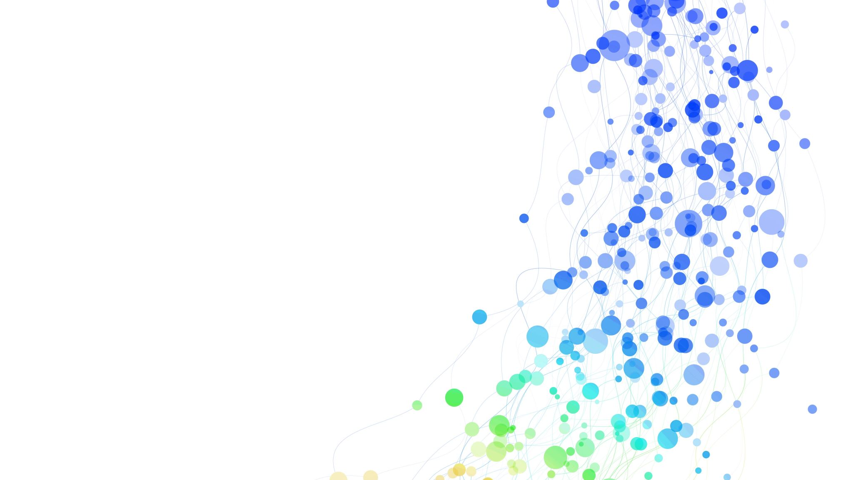
Apache2 History
Once in the system the hacker:
Found open SSH port to access the system
Checked the credentials they were able to log in as
Created a temporary file because anyone can write to it
Used net tools to control the website
Archived the temp file to hide it

Slide 13
Asking Clarifying Questions
When stating there was a cartoon on his screen clarify if he was visiting a website or is on his desktop
Clarify when he started seeing the cartoon on the screen
Clarify what he was doing prior to seeing the cartoon on the screen
Clarify if he can close the window with the cartoon character on it

Slide 14
Steps to Prevent Further Incidents

Slide 15
Make SSH inaccessible to outside ports
Create a strong password policies policy
- Minimum password length of 12 characters
- Password complexity (must include numbers and special characters)
- Password lockout after so many attempts
Create Key SSH Authentication
No root SSH
Update Firewall rules

